Slide 1

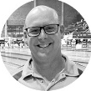


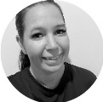






Age 13+
Club Training
Squad Pathway
Coach Rob
National Squad Tier 1 & 2
Coach Zach & Coach Andy
Age 12-15
Age 15+
Coach Nath
State Performance Squad
State Open Squad
Age 12-15
State Squad
Coach Macy
Coach Will
Age 8 - 11
Coach Coop
Age 12+
Junior Performance Squad
Country Squad
If age 12+
Coach Brooke
Coach Alicia
Age 8 - 11
Age 12+
Junior Development Squad
If age 12+
Intermediate Squad
Learn to Swim Program
Transition Squad
DEVELOP – PROGRESS - ACHIEVE

